Slide 1

Begripsam
”Understandish”
UD2014 The web and cognitive disabilities 18th of June 2014
Notes:
This is a project about cognitive accessibility
One way to define accessibility is to say that something is accessibie when it works for everyone, regardless of any disabilitie. That would mean that something is cognitively accessible when it works for people who have various kinds of cognitive impairments.
Begripsam is a word that doesn’t exist in the Swedish language. Neither does it translate or exist in English. I means “Easy to understand”.
There is a standarised symbol for cognitive accessibility that we use.
In this project we are exploring how to develop better user participation through assessments and we create impact in both the design process and in standardization where ordinary methods do not work well for persons with cognitive disabilities

Slide 2
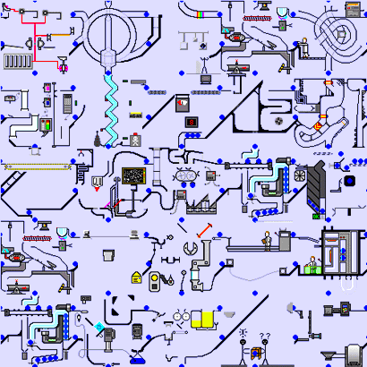
Cognition
The mental process,
when we:
Receive information
Process information
Deliver information
Remember information
Navigate in time and space
Solve problems
Comprehend numbers
Comprehend language
Brain: Described by a person with ADD
Notes:
And talking about cognition we say that it is a mental process, when we receive information, process it and decide how to use the information.
We use our memory to store, retrieve and use experiences and skills. We use our skills when we move in time and space, and when we solve problems and when we understand numbers, language and to read text is also a cognitive ability.
Having difficulty with any of these functions leads to cognitive problem.
People with cognitive disabilities may have have difficulty understanding abstract things, to remember, to plan, to solve problems, to understand language, to read, to write, to organize things, to orientate themselves or to concentrate.

Slide 3
Project aim of "Begripsam":
To highlight the cognitive and linguistic aspects in the concept of accessibility
To be part and influence the development of products, services, standards and guidelines
To create new and useful working forms for users and user organizations
Notes:
In "Begripsam" we want to highlight the cognitive and linguistic aspects of the accessibility concept. Our definition on Cognititive accessibility is to recive and transform information easily and to be able to decide how this information will be used.
The overall approach is “Design side by side” meaning that the researcher and the persons with different disabilities work closely together to find new methods that work. These methods allready has and can in future influence the development of products, services, standards and guidelines
An other aim is to describe useful working forms for users and their user organizations in order that they can go on working with accessibility even when the poject is finished in three years.
In order to do that our projet is organized like this……

Slide 4
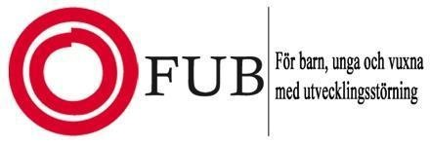



Organization
Steering committee
Persons with cognitive disabilities
Experts
Project managers
Network
Notes:
The project consists of three organizations, The Dyslexia Association, The Swedish National Association for Persons with Intellectual Disability and The Autism and Asperger Association and the contributers belong to these orgnisations.
They work in a team of 20 persons with different diagnoses. The diagnoses are autism and aspergers syndrom, ADHD, Dyslexia,,Language disorder, Mental retardation och learning disability.
We Started the project1 juli 2013 and will continue untill 2016. Project managers are Kerstin Ivarson Ahlstrand och Torbjörn Lundgren.
Expersts och project team consists of me, master in special education. Hans Hammarlund, expert in dyslexia and learning disabilities, Eva Hedberg, who you have met today. Stefan Johansson, research student at KTH that you will meat later today. And we have experts from the three organizations
The network consists of researhers, other experts, associations, authorities, agencies working with standardization, developpers of web information.
We have a web page where you find information and material on how language and communication functions in relation to human abilities and to technical solutions.
Material about the project Begripsam is published on fungerande medier. This web page is adressed to all team members and to other persons intrested in these subjects.
The first year was founded by three organizations The Swedish Post and Telecom Authority, The Swedish Consumer Agency and The Swedish Inheritance Fund Commission
I will tell more about our working model

Slide 5
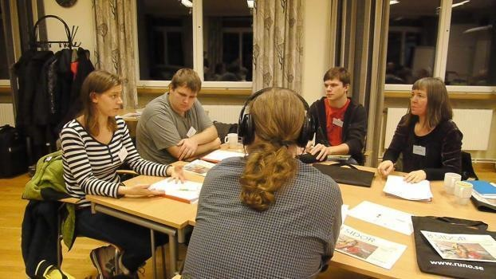
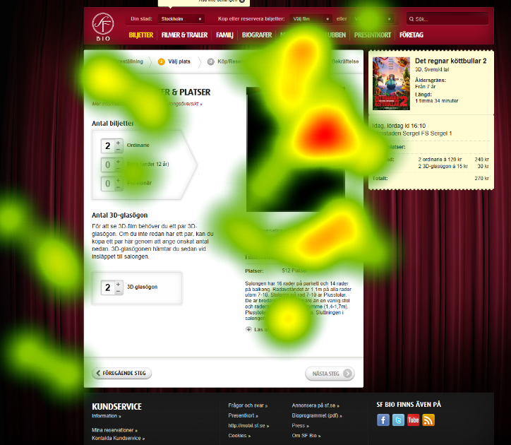
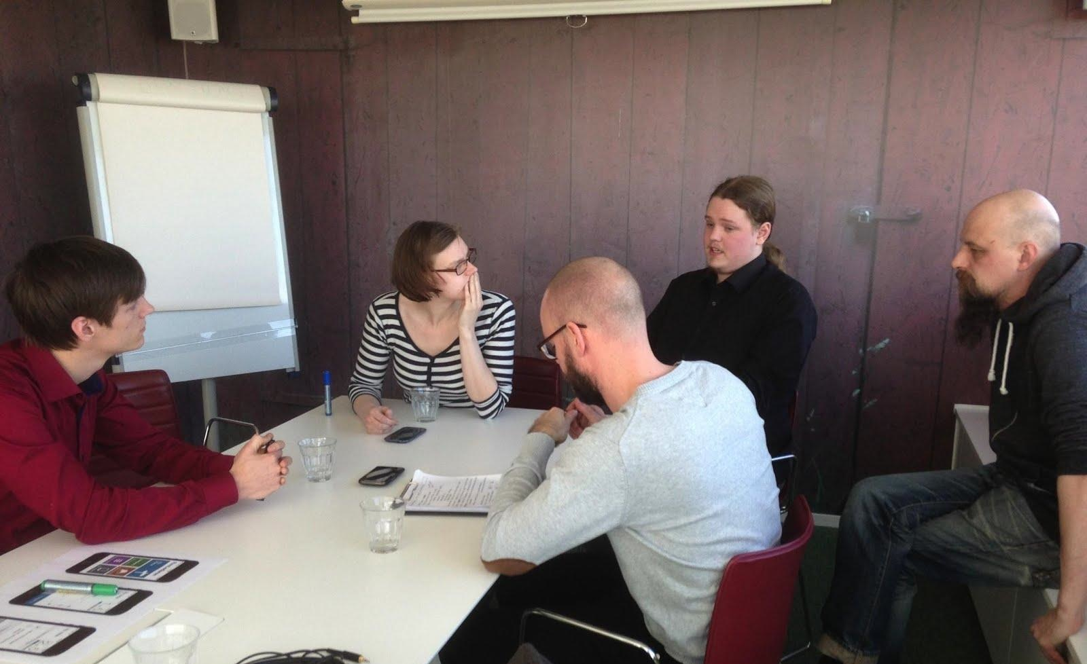

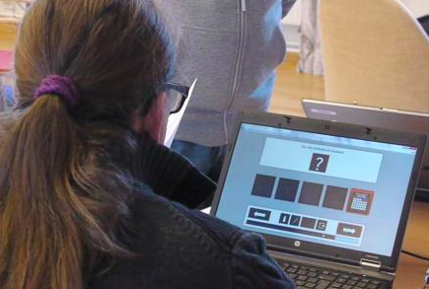
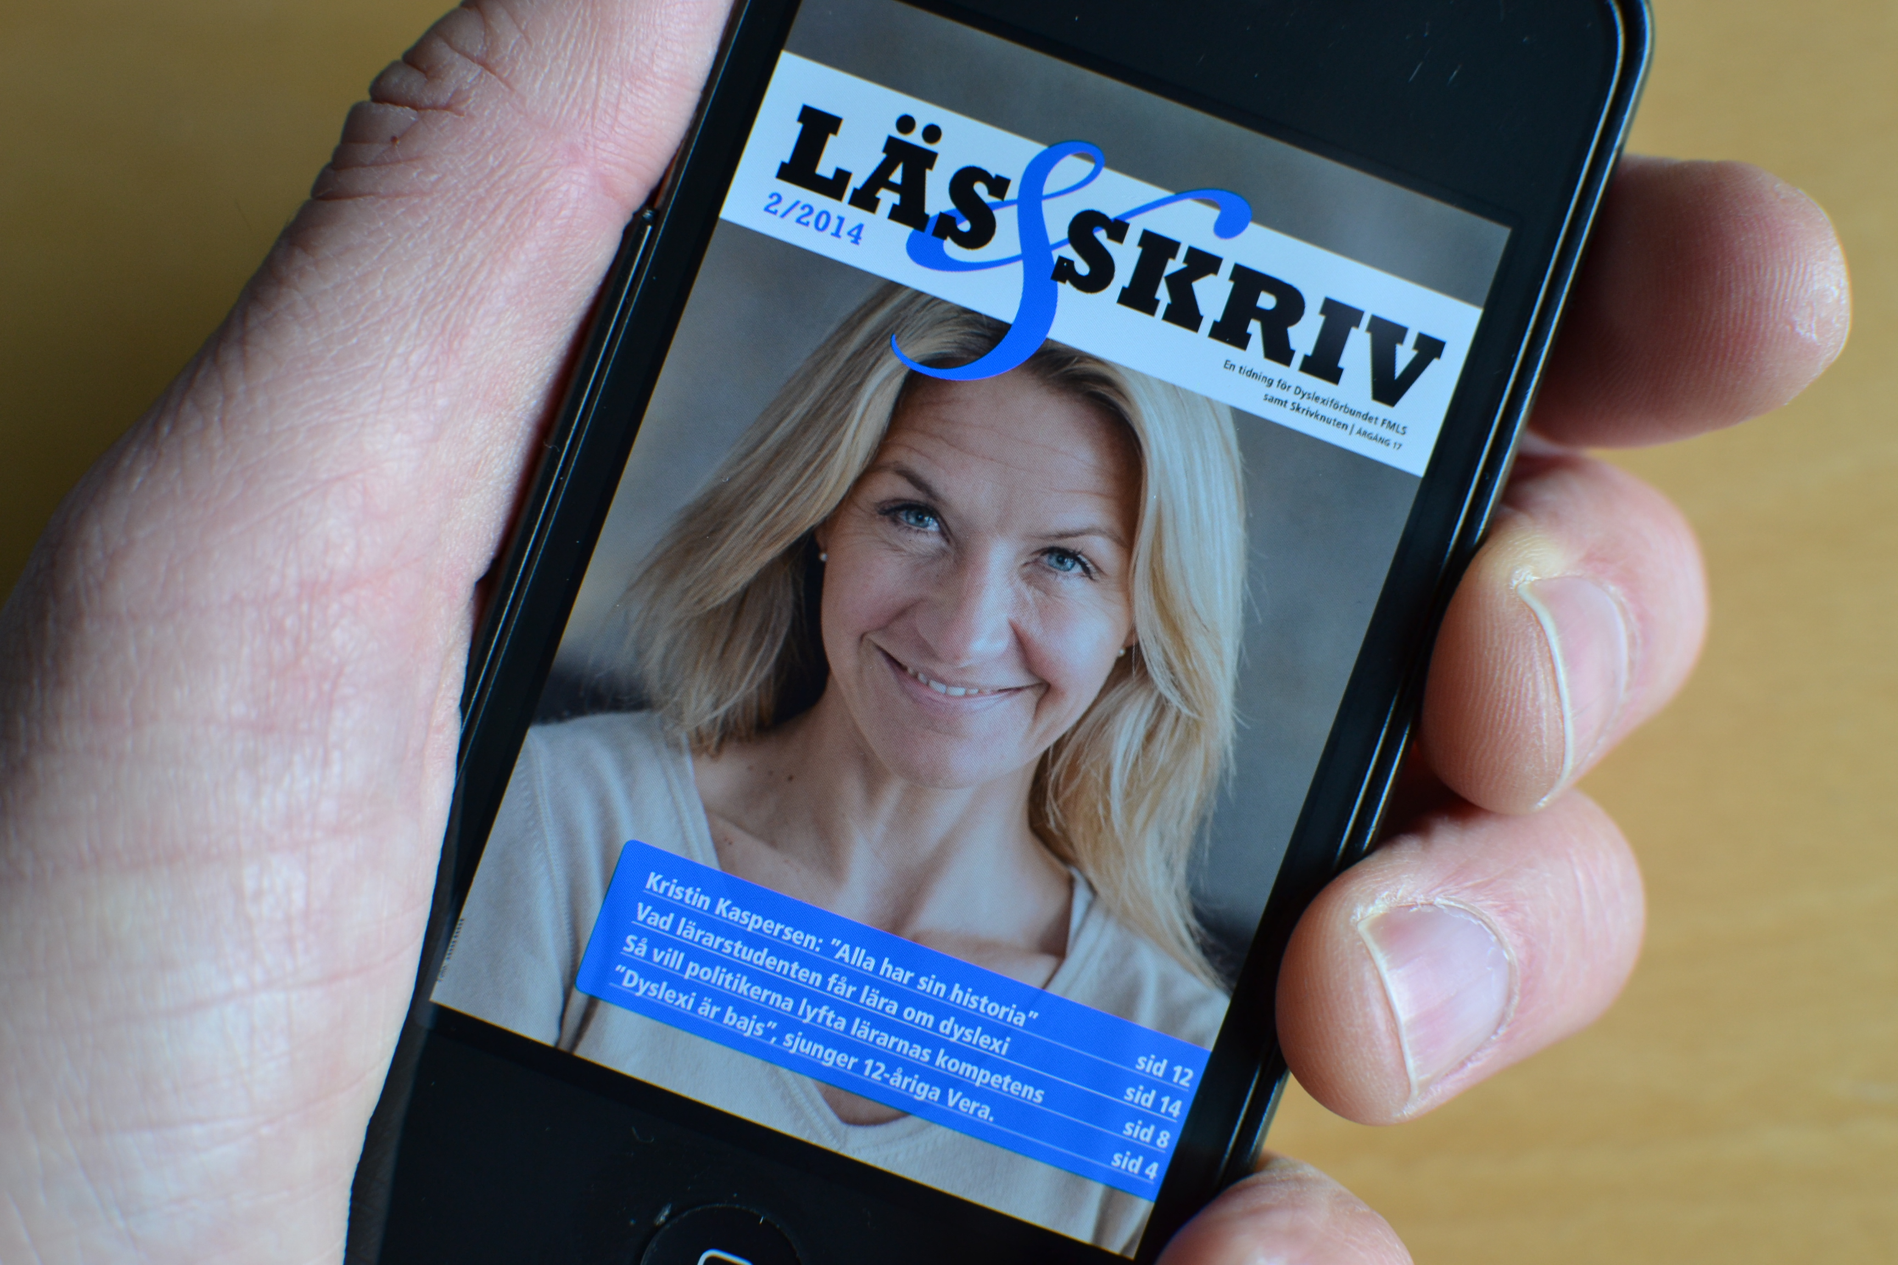

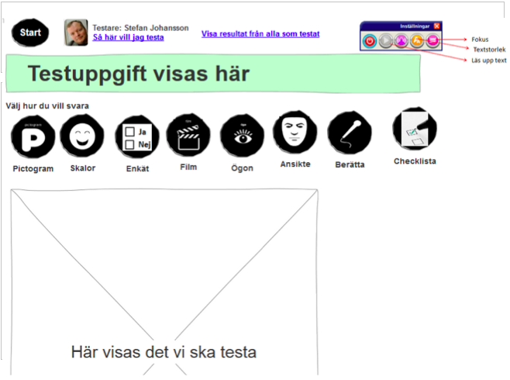
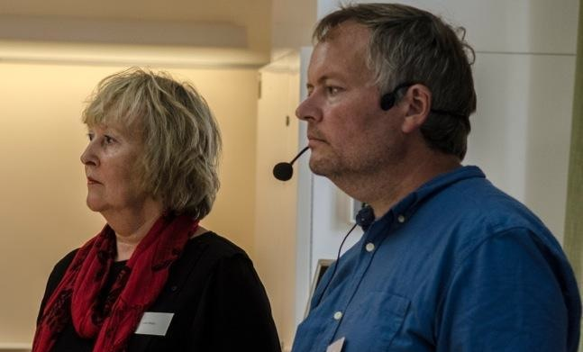
Working areas
Track 1
Track 2
Track 3
Education
Method inventory
And development
Impact on design processes
Standardization
Notes:
The Swedish Consumer Agency and The Swedish Inheritance Fund Commission is our main founders. We work in three tracks.
A goal for the project is that the members should be confident and competent to be able to represent users with all cognitive disabilities. In for example standardization groups and other regulatory bodies.
Track 1 is an important part of the project when one person educates the rest of the group to understand how it is to live with a specific diagnose.
The group meet in a a boarding school, a Folk high school outside Stockholml, four times a year in weekends, totally 12 days a year. Each time 3-4 persons “tell their story” and afte rthat presentation an expert in the diagnose give a more scientific lecture.
They have also got education in the Web Content Accessibility Guidelines, WCAG 2.0, Principles, Guide lines and Success Criterias.
In Track 2 we are using and evaluating more traditional data collecting tools. In this project there are 20 participants with intellectual disabilities, dyslexia, adhd, autism and Asperger’s syndrome. All participants have severe chalanges regarding cognition. The differences between groups are significant but the differences between members in each group are also significant. So in fact every member in the project can be described as having an individual cognitive profile.
It is impossible to use one single method or tool for data collection. if you want to work with the whole group. Some participants think that surveys are excellent (well not many, most of them hate surveys). Some can only use pictures and someparticipants want to answer by telling a story. Some just want the computer or some other device to register what they do and how they react, a sort of passive “participating by doing”.
We have tested different kind of user testing, surveys, interviews, group discussions, eye tracking, card sorting. We have discussed, but not tested, more futuristic approaches as affective interfaces. One participant said he may evaluate things by become a human smiley. A computer could then register if he was happy or sad.
Focus in the beginning has been on data collection. We often don’t know if something is working well for persons with cognitive disabilities because they are often “invisible” in for example surveys or other studies.
We have developed a mix of old and new methods and tested them. The findings so far suggest that there are digital gaps between persons with cognitive disabilities and the main stream society
,
Track 3
Each session we work with real test cases. So far the group has evaluated Sweden’s largest cinema network.
different kind of software to protect passwords
functionality for comments on newspaper websites.
Representatives for government agencies, public sector and commercial companies are invited and the interest of cooperating with the group has grown rapidly.
The last meeting we started something that many of the members find really difficult: how are we supposed to affect something that does not yet exist? The Swedish Consumers Board attended at the meeting and said: Help us with a new website. “Tell us what we should do to make it easy for you to use”. For some of the users this is almost impossible. They find it hard to test something that exists so how on earth could they say something constructive about something that still is in the head of someone else?
It’s a paradox that it is at this point your opinion can make a big differens. Later on in the process you might adjust smaller things.
So we had to start a discussion on how to understand the intention or the idea and how to say something meaningful to your client. One way of doing that is to provide a checklist. The knowledge we have as a group could maybe be delivered to the client in form of a checklist. Another way is to ask the client to construct more concrete issues. If the level of abstraction can be lowered it will be easier to cooperate with the client. Another important thing is to give time for reflection. Many members in the group need a longer or shorter period of thinking before they are ready to say something.
Some of us in the expert group are members in work groups in Swedish standards Institute and we plan to involve our participants.

Slide 6

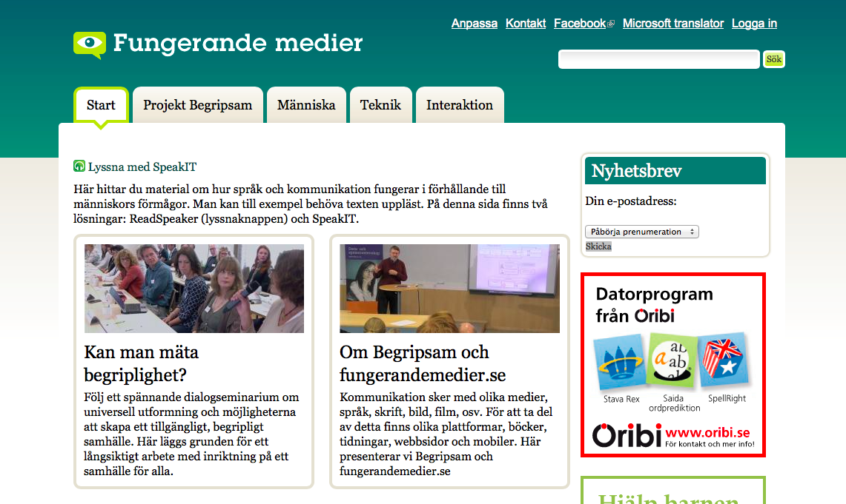
www.fungerandemedier.se
Notes:
This web page is of course in Swedish but with Microsoft translator you can get an idea of the material.

Slide 7
Problems with current standards
UD2014 The web and cognitive disabilities 18th of June 2014
Notes:
The standards and guidelines for accessibility that exist today have shortcomings. There is no such thing as would improve for those with cognitive difficulties. The standards therefore provide better support for people with other types of disabilities.
A big reason for the failures is the lack of knowledge, or perhaps we should rather say that the knowledge is not sufficiently documented. There are many who have experienced a lack of cognitive availability, but these experiences are often not investigated and published in a scientific context. The experience reaches not to groups working with standardization or formulate rules.

Slide 8
WCAG 2.0 – 4 main principles
1 Perceivable
2 Operable
3 Understandable
4 Robust

Slide 9
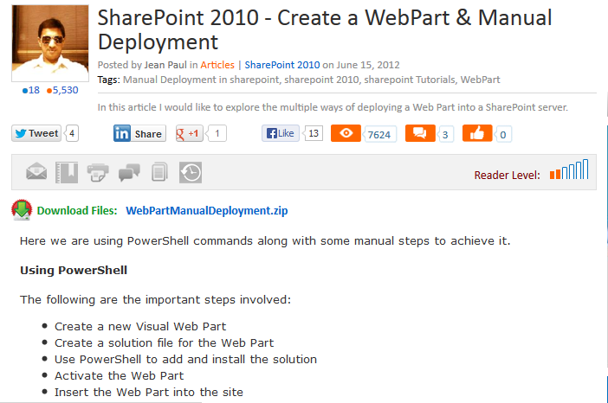
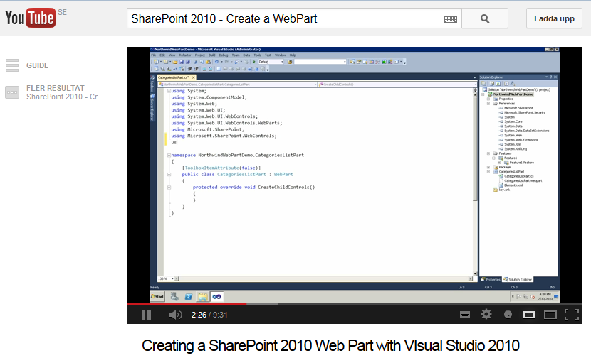
According to WCAG
correct…
not enough…
Notes:
Or maybe it should be an easier text version if the reading level is too high?
In both cases, we obtain information on how to create a so-called "Web Part". The first is a traditional manual. By following the step by step written instructions it will be right. The second case gives the same information but through a movie. This would not qualify according to the WCAG 2. To get it would be necessary to add text.:

Slide 10
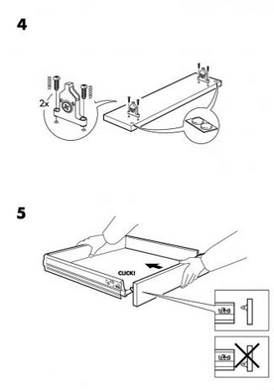
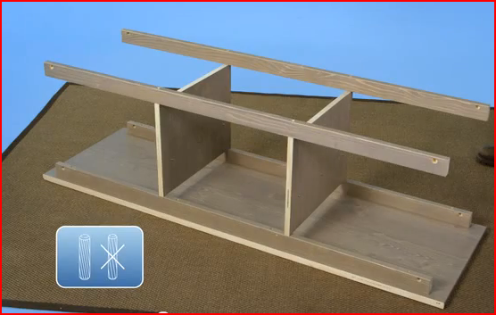
IKEA
IKEA use illustrations and films to help the user. If you are lucky the result will be a complete piece of furniture…
But would it be easier to follow a text instruction?

Slide 11



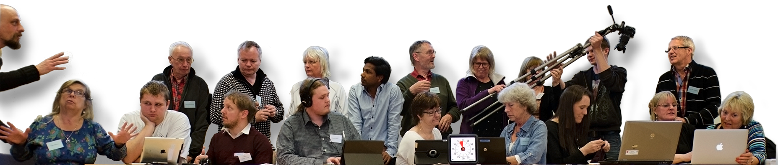
Final design - Project model
Direct impact
Web sites
Universal design
Tests
Create new tests
Change existing tests
Rules
Create new rules
Change existing rules
?
✔
Ja
✗
⏏⌥
♪
♪
þ☐
⌫
?
Nej
♪
⏎
♯
Notes:
All together ended up with new modells of the project. It was really fantastic to realize that now they were ready for their own ideas.
The final and best way to visualise the project. You can see the hole group in activity with lamps symbolizing their ideas, quest marks for not answerd questions and other symbols from surways and questionaries on the notelines . Together they make the musik.
This will probably not be the last design of the project.
The printed material develloped together with the participants is avaliable here today.

